Slide 1
COMP 4500
Week 1 - Friday

Slide 2
Last time
Finished Big Theta examples
Proof techniques
Tractability

Slide 3
Questions?

Slide 4
Logical warmup
For Diwali, Mr. Patel's five daughters gave each other books as presents.
Each presented four books and each received four books, but no two girls divided her books in the same way.
That is, only one gave two books to one sister and two to another. Bharat gave all her books to Abhilasha; Chandra gave three to Esha.
Who gave how many books to whom? (Mr. Patel's fourth daughter is named Deeti.)

Slide 5
Proving Universal Statements

Slide 6
A useful definition
We'll start with basic definitions of even and odd to allow us to prove simple theorems
If n is an integer, then:
  n is even ⇔ ∃ k ∈ Z such that n = 2k
  n is odd ⇔ ∃ k ∈ Z such that n = 2k + 1
Since these are bidirectional, each side implies the other

Slide 7
Generalizing from the generic particular
Pick some specific (but arbitrary) element from the domain
Show that the property holds for that element, just because of that properties that any such element must have
Thus, it must be true for all elements with the property
Example: ∀x ∈ Z, if x is even, then x + 1 is odd

Slide 8
Direct proof
Direct proof uses the method of generalizing from a generic particular, following these steps:
  Express the statement to be proved in the form ∀x ∈ D, if P(x) then Q(x)
  Suppose that x is some specific (but arbitrarily chosen) element of D for which P(x) is true
  Show that the conclusion Q(x) is true by using definitions, other theorems, and the rules for logical inference

Slide 9
Direct proof example
Prove the sum of any two odd integers is even.

Slide 10
Proof by contradiction
In a proof by contradiction, you begin by assuming the negation of the conclusion
Then, you show that doing so leads to a logical impossibility
Thus, the assumption must be false and the conclusion true

Slide 11
Contradiction formatting
A proof by contradiction is different from a direct proof because you are trying to get to a point where things don't make sense
You should always clearly state that it's a proof by contradiction
You will reach a point where you have p and ~p, mark that as a contradiction
If you're doing a proof by contradiction and you actually show the thing you wanted to prove in the first place, it's not a proof!

Slide 12
Proof by contradiction example
Theorem: There is no integer that is both even and odd.
Proof by contradiction: Assume that there is an integer that is both even and odd

Slide 13
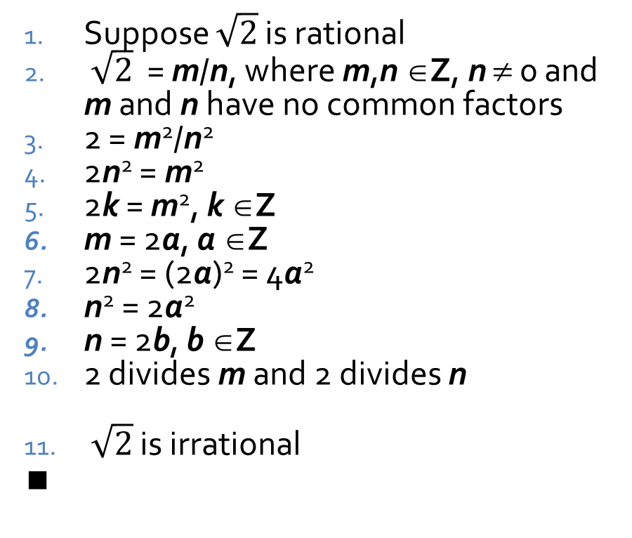
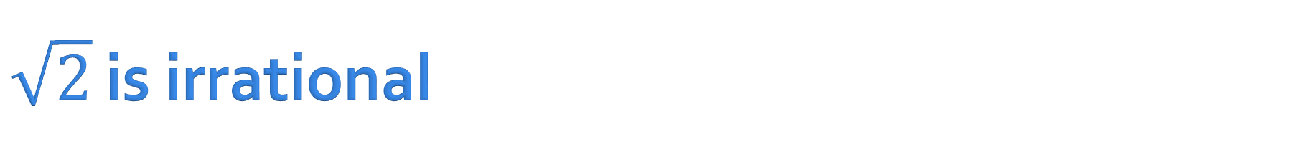
$\sqrt{2}$ is irrational
Theorem: $\sqrt{2}$ is irrational
Proof by contradiction:
Suppose $\sqrt{2}$ is rational
$\sqrt{2}$ = m/n, where m,n ∈Z, n ≠ 0 and m and n have no common factors
2 = m²/n²
2n² = m²
2k = m², k ∈Z
m = 2a, a ∈Z
2n² = (2a)² = 4a²
n² = 2a²
n = 2b, b ∈Z
2 divides m and 2 divides n
$\sqrt{2}$ is irrational
∎
Negation of conclusion
Definition of rational
Squaring both sides
Multiply both sides by n²
Square of integer is integer
Even x² implies even x (Proven elsewhere)
Substitution
Transitivity
Even x² implies even x
Conjunction of 6 and 9, contradiction
By contradiction in 10, supposition is false

Slide 14
Asymptotic Order of Growth

Slide 15
Rule of thumb
We want a way to bound the size of an algorithm's running time in terms of its input size
Measuring the exact number of operations would be a lot of detailed work
  Which would probably be invalid in a different programming language or on a different processor
Instead, a simplified, rough outline of the speed at which a running time increases with input size is more useful

Slide 16
Upper bounds
Let T(n) be the running time of an algorithm
Let f(n) be a non-decreasing function
T(n) is O(f(n)) if and only if
  T(n) ≤ c∙f(n) for all n ≥ n₀ where n₀ ≥ 0
  for some positive real numbers c and n₀
In other words, past some arbitrary point, with some arbitrary scaling factor, f(n) is at least as big
We say that T(n) is upper bounded by f(n)

Slide 17
Lower order terms don't matter
Why not?
We can assume that n ≥ 1
In that situation, n ≤ n² ≤ n³ ≤ n⁴, etc.
Thus, they can get wrapped into our constant:
  pn² + qn + r ≤ pn² + qn² + rn² = (p + q + r)n²
From a practical perspective, lower order terms will also have relatively no impact when n gets large

Slide 18
Lower bounds
Let T(n) be the running time of an algorithm
Let f(n) be a non-decreasing function
T(n) is Ω(f(n)) if and only if
  T(n) ≥ ε∙f(n) for all n ≥ n₀ where n₀ ≥ 0
  for some positive real numbers ε and n₀
In other words, past some arbitrary point, with some arbitrary scaling factor, f(n) is no bigger
We say that T(n) is lower bounded by f(n)

Slide 19
Tight bounds
Let T(n) be the running time of an algorithm
Let f(n) be a non-decreasing function
If T(n) is O(f(n)) and Ω(f(n)), we say that T(n) is Θ(f(n))
In other words, past some arbitrary point, with some arbitrary scaling factor, f(n) grows at about the same rate
We say that T(n) is tightly bounded by f(n)

Slide 20
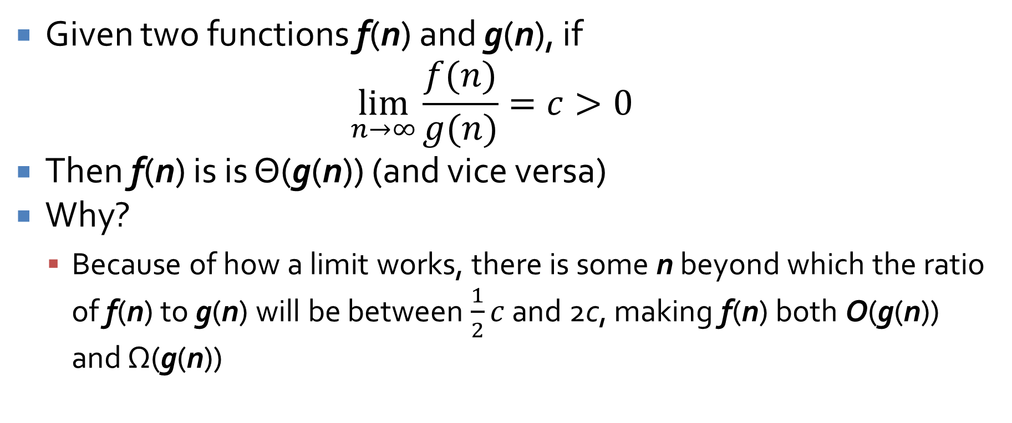
Another way to look at tight bounds
Given two functions f(n) and g(n), if
$$\lim_{n→∞}{\frac{f(n)}{g(n)}=c>0}$$
Then f(n) is is Θ(g(n)) (and vice versa)
Why?
  Because of how a limit works, there is some n beyond which the ratio of f(n) to g(n) will be between $\frac{1}{2}c$ and 2c, making f(n) both O(g(n)) and Ω(g(n))

Slide 21
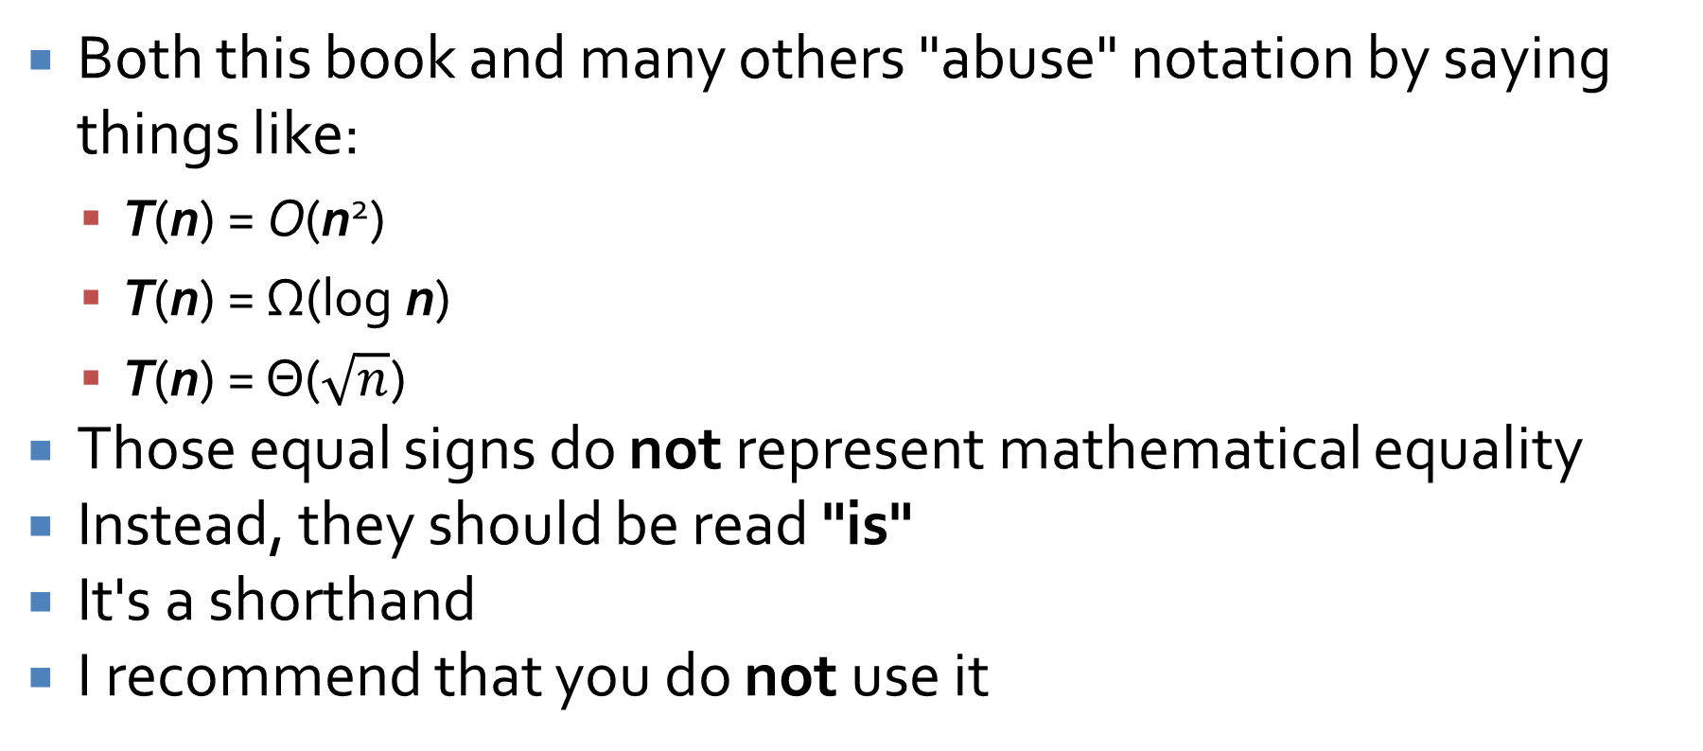
Abuse of notation
Both this book and many others "abuse" notation by saying things like:
  T(n) = O(n²)
  T(n) = Ω(log n)
  T(n) = Θ($\sqrt{n}$)
Those equal signs do not represent mathematical equality
Instead, they should be read "is"
It's a shorthand
I recommend that you do not use it

Slide 22
Properties of Asymptotic Bounds

Slide 23
Transitivity
If f(n) is O(g(n)) and g(n) is O(h(n)), then f(n) is O(h(n))
If f(n) is Ω(g(n)) and g(n) is Ω(h(n)), then f(n) is Ω(h(n))
If f(n) is Θ(g(n)) and g(n) is Θ(h(n)), then f(n) is Θ(h(n))
Prove it.

Slide 24
Sums
If f(n) is O(h(n)) and g(n) is O(h(n)), then f(n) + g(n) is O(h(n))
Prove it.
If g(n) is O(f(n)), then f(n) + g(n) is Θ(f(n))
  This is another way of showing that lower order terms don't matter.

Slide 25
Polynomial bounds
A polynomial of degree d can be written as f(n) = a₀ + a₁n + a₂n² + … + a_{d}n^{d}, where a_{d} > 0
For any such polynomial, f(n) is Θ(n^{d})
To prove this, note that any term a_{j}n^{j} ≤ |a_{j}|n^{d} when n > 1

Slide 26
Logarithms
There is a function called the logarithm with base b of x defined from R⁺ to R as follows:
  log_{b} x = y ⇔ b^{y} = x
Logarithms are very slowly growing functions, slower than any polynomial function:
  For any b > 1 and every x > 0, log_{b} n is O(n^{x})
  Even n^{0.00001} grows faster than log n

Slide 27
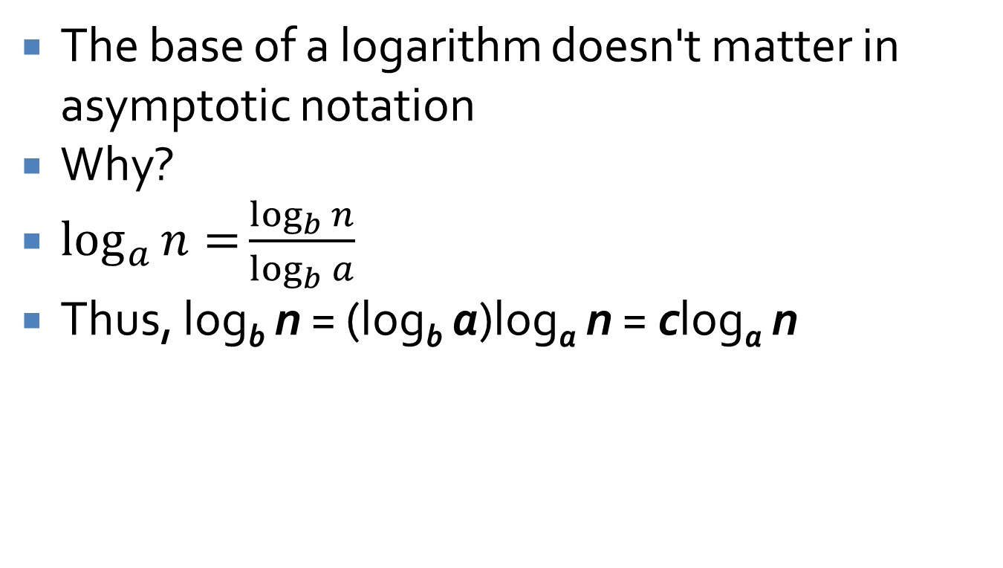
Bases don't matter
The base of a logarithm doesn't matter in asymptotic notation
Why?
$\log_{a}{n=}{\frac{\log_{b}{n}}{\log_{b}{a}}}$
Thus, log_{b} n = (log_{b} a)log_{a} n = clog_{a} n

Slide 28
Exponential bounds
On the other end of the spectrum, any exponential with a base r > 1 will grow faster than any polynomial
  For every r > 1 and every d > 0, n^{d} is O(r^{n})
  Even 1.0001^{n} grows faster than n¹⁰⁰⁰
People talk about "exponential time," but all exponents are actually different
  For every r > 1 and every s > r, r^{n} is O(s^{n})

Slide 29
Three-sentence Summary of Stable Marriage and Five Representative Problems

Slide 30
Stable Marriage

Slide 31
Imagine n men and n women
All 2n people want to get married
All of them are willing to marry any of the n members of the opposite gender
Each woman has ranked all n men in order of preference
Each man has ranked all n women in order of preference
We want to match them up so that the marriages are stable

Slide 32
Stability
Consider two marriages:
  Anna and Bob
  Caitlin and Dan
This pair of marriages is unstable if
  Anna likes Dan more than Bob and Dan likes Anna more than Caitlin or
  Caitlin likes Bob more than Dan and Bob likes Caitlin more than Anna
We want to arrange all n marriages such that none are unstable

Slide 33
Upcoming

Slide 34
Next time…
Finish stable marriage
Five representative problems
Implementing stable marriage

Slide 35
Reminders
No class Monday!
Read Section 2.3
Assignment 1 is due next Friday

